Slide 1


Slide 2

Core Lessons with Jon
Week 5: Understanding the Mind-Body Connection

Slide 3

Visualization & Weight Loss
Communicate to your body that
you want to be thin
Reduce stress
Work through emotional issues
Heal digestion issues
Activate the GTGE adaptation

Slide 4

More Ways to Use
Visualization for Weight Loss
Eliminate junk food cravings
Create positive habits
Improve energy & vitality
Change dysfunctional beliefs
Increase your intuition and internal guidance
Manifest success & live the life of your dreams

Slide 5
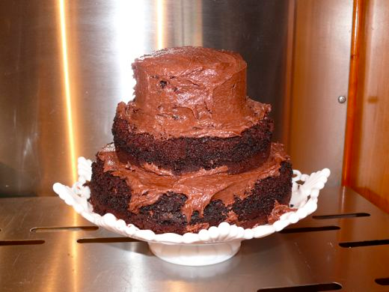
Eliminate Junk Food Cravings
Mind doesn’t know the difference between real & imagined experience
Visualize chocolate cake – see what happens
Imagine a negative experience with chocolate cake – now see what happens
Do this only after you’ve made progress turning off the FAT programs

Slide 6
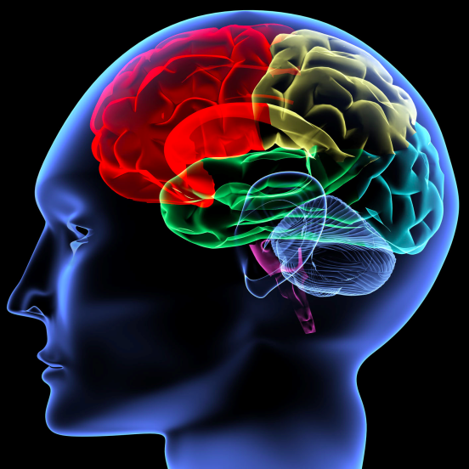
Create Positive Habits
Our brains are habit forming machines
We don’t know how to program them
Once you learn how to program your brain to make positive habits you can create any habit you like
Quick lesson is brain programming

Slide 7

We are All Computer Programmers
Want to tap into the power of your mind?
You have to first learn how program your body/mind

Slide 8
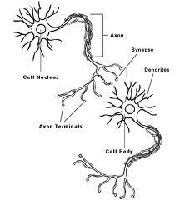
Language of Your Brain
Thought / Action
Impressions
Associations
Habits
Addictions

Slide 9
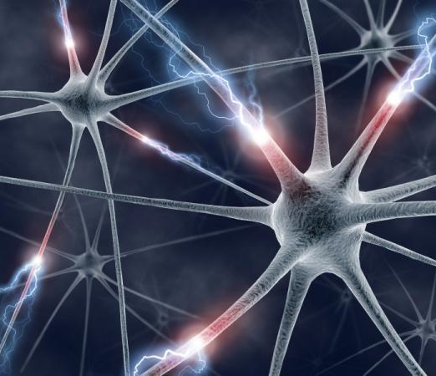
Brain Cells & Habits
First meeting – impression
Second time – association
Third time – habit
Emotional/chemical charge - addiction

Slide 10

Brain Cells Are Like People
When we meet someone the first
time we form an impression
Second time – Acquaintance
Third Time – Friend
Many times – If they satisfy our
needs/ create pleasure - Addiction

Slide 11

We’re Constantly Creating Paths
Every thought, action, feeling or image you have locks into the brain’s program & starts creating
a path.
Known as the Neural Network
Mirror Neurons: just watching someone else is creating a path

Slide 12
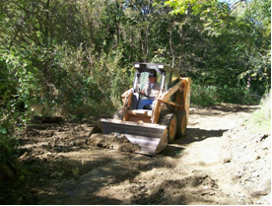
Visualization Is Like a Bull Dozer
Trying to create a habit in normal waking state is like walking on a path through the woods – can take months
When you’re in SMART mode you create brain connections very quickly
Children spend most of their time in SMART mode, which is why they are so impressionable
It’s like using a bull dozer to create the path

Slide 13

Imagine Any Habit…
Whatever habit you’d like create, visualize yourself doing the action
and it will quickly become a habit
You are tapping into the bull dozing power of your mind to create positive habits quickly and easily.

Slide 14
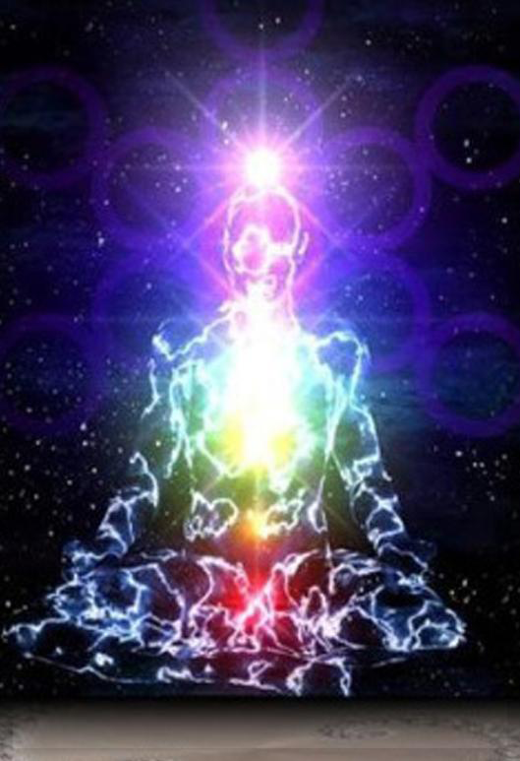
Use Visualization to
Open Your Energy Channels
The concept of energy channels in Eastern medicine has been well established
Our bodies have life force energy that controls, operates and energizes us

Slide 15

Life Force Energy
Western medicine rarely gives it credence
100,000 reactions happen every second in every cell
All these reactions have to happen in a coordinated sequence
It’s impossible for our bodies to operate through just electricity and chemicals

Slide 16
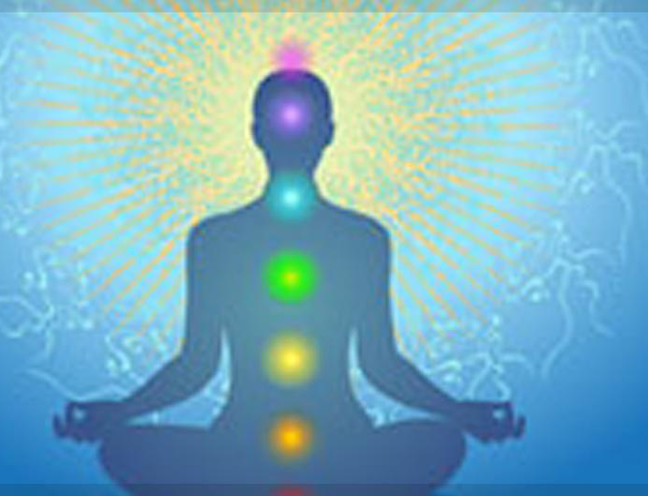
Understanding Your Energy
Discovering our bodies have an electrical impulse
Connective tissue is actually a semi-conductor for energy
Bodies run on energy
Eastern medicine has known this for thousands of years

Slide 17
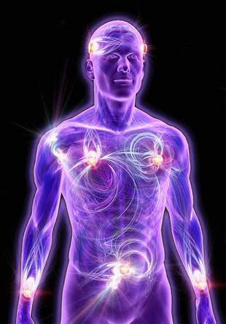
Energy Channels
Our bodies have energy channels
Main arteries, blood vessels, veins and capillaries go all over our bodies
Bring nourishment
Energy channels allow life force energy to go all through our bodies and energize us

Slide 18
Energy Channels
Open and flowing
Closed and
blocked
Life force to all
parts of your body
Lots of problems…

Slide 19

Blocked Energy Channels
Weak, devitalized
Diseases
Consistently craving sugar
More stressed out

Slide 20
Vicious Cycle
More blocked your energy channels are
More tired
More stressed
More blockages in your body
More weight you gain
Harder your life gets

Slide 21

Blocked Energy Channels
Means parts of your body are cut off from life force energy
This means dying, decaying, stagnating energy
It causes a number of health problems

Slide 22

What Blocks Channels?
Negative thoughts
Fear
Stress
Your energy channels constrict when they don’t want negative energy to enter

Slide 23
Positive thoughts
Higher energy
Higher vibration
Negativity, jealousy, resentment, hatred
Lower type of energy vibration

Slide 24
Higher emotion
Clear water
Negative emotion
Thick molasses
Gets stuck in energy channels
Energy can’t flow

Slide 25

Negative Spiral
Chronic state of exhaustion
More tired, exhausted, blocked, weak, devitalized, stressed out
Activates your FAT Programs
Causes junk food cravings
Makes you heavier

Slide 26
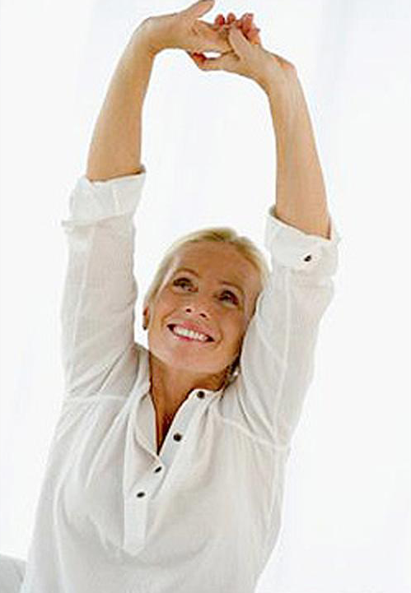
Open Energy Channels = Positive Spiral
You have more energy
You crave less junk food
Life is less stressful
You lose weight easier
You feel happier
Positive momentum develops
in your life

Slide 27
“Studies show that points on the life force meridians have much lower electrical resistance (averaging 10,000 ohms at the center of the point) when compared to the surrounding skin (which averages a much higher 3,000,000 ohms).
Among other characteristics, acupuncture points propagate acoustic sound better than does the surrounding skin. They also emit small amounts of light and greater amounts of carbon dioxide. When the points are stimulated with a low-frequency current, the body responds by producing endorphins and cortisol. When they are stimulated with a higher-frequency current, the body produces serotonin and norepinephrine. When the surrounding skin receives the same current, these neurochemicals are not produced.”
- Dawson Church, PhD, author of The Genie in Your Genes

Slide 28

Energy Moves With Mind
You can use visualization to open up your energy channels
White Light Meditation

Slide 29

Visualization Changes
Dysfunctional Beliefs
Change your beliefs & you change your entire emotional state
Imagine every cell of your body saying repeating the desired belief

Slide 30

Weight Loss Is Easy
When Your Body Wants To Be Thin
Old weight loss paradigm = like trying to walk through a sliding glass door
Turning off your FAT programs = opening the invisible sliding glass door
Imagine every cell of your body repeating the words – “Weight Loss is easy, effortless & automatic”

Slide 31

When You Visualize,
You Strengthen Intuition
Muscle that gets stronger and stronger with use
But, we haven’t used it since we were kids…
Meditation/visualization – A path for strengthening intuition
Will make you feel safer than anything else in the world

Slide 32

Manifest The Life Of Your Dreams
Mind: manifesting device
Tool to really create our world
If you visualize what you want to happen, it will happen
My own experience w/ visualizing my ideal life
Abundance Visualization – Ocean of Abundance

Slide 33

This Week’s Action Steps
This week’s morning visualization: Abundance Visualization
Do mid-afternoon visualization
Do evening visualization each night before bed

Slide 34
Ongoing Steps
Drink 2 glasses of water w/lemon or apple cider vinegar, and probiotic.
Drink a green juice, upon rising or in late afternoon.
Eat a great blood sugar balancing breakfast
Take additional probiotic supplement & digestive enzymes with meals.
Eat frequent Gabriel Method friendly meals during the day, have an early dinner
Daily: Take an afternoon stress reduction break/ visualization
1 or more times per week: Fit in a yoga, tai chi or meditation class
Try 10 mins. of Get Thin or Get Eaten exercises 2-3 times per week
Drink a glass of water before each meal
Listen to evening visualization

